Slide 1
2024/06/13
Seminar for International students
On Submodularity and Controllability in Complex Dynamical Networks presenter: Jingran SU
Authors: Tyler H. Summers, Fabrizio L. Cortesi, and John Lygeros IEEE Transactions on Control of Network Systems
vol. 3, no. 1, pp. 91-101, March 2016

Slide 2
Contents
Motivation
Linear models of network dynamics
Optimal sensor and actuator placement in networks
Numerical examples
Conclusions and outlook

Slide 3
01
Motivation

Slide 4
Motivation
Controllability and observability are fundamental structural properties of dynamical systems, originally established in the seminal work of Kalman in 1960. These properties are crucial for understanding how to influence and measure the state of a system.
A basic problem is sensor and actuator placement: choose a subset from a ﬁnite set of possible placements to optimize some real-valued controllability and observability metrics of the network.
In this paper, we show that the controllability and observability Gramians, previously thought to lead to difﬁcult combinatorial optimization problems can be in fact easily optimized, even for very large networks.
The results are illustrated on randomly generated systems and on a problem of power electronic actuator placement in a model of the European power grid.

Slide 5
02
Linear models of network dynamics

Slide 6
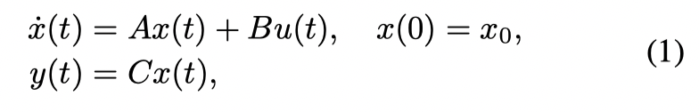
Linear models of network
A linear, time-invariant dynamical network models:
x(t) ∈ R^{n} are the states of the network,
u(t) ∈ R^{m} are the control inputs that can be used to inﬂuence the network dynamics,
y(t) ∈ R^{p} are the outputs.
A, B, and C are constant matrices of appropriate dimensions.

Slide 7
Linear models of network
Interpretation of matrix A, B and C
We assume that C ∈ R^{p×n} is full row rank, a weight matrix whose rows deﬁne important directions in the state space.
The dynamics matrix A induces a graph G (V, E) of the network in which the vertices correspond to states, i.e., V = { 1, ..., n } and the edges correspond to non-zero entries of A, i.e., (i, j) ∈ E whenever a _{ji} ≠ 0.
The non-zero entries of the input matrix B describe how each actuator affects the nodes in the network.

Slide 8
Controllability
Definition 1 (controllability): A dynamical system is called controllable over a time interval [0, t] if given any states x ₀ , x ₁ ∈ R ^{n} , there exists an input u(·) : [0, t] → R ^{m} that drives the system from x ₀ at time 0 to x ₁ at time t.
It refers to the ability of an external input to move a system from any initial state to any desired final state within a finite time period.
Kalman’s well-known rank condition states that a linear dynamical system is controllable if and only if [B, AB, ..., A ^{n−1}B] is full rank.

Slide 9
Energy-related controllability metrics
The symmetric positive semideﬁnite matrix
is called the controllability Gramian at time t and provides an energy-related quantiﬁcation of controllability.
Eigenvectors of W_{c} associated with small eigenvalues (large eigenvalues of W_{c} ⁻¹ ) deﬁne directions in the state space that are less controllable (require large input energy to reach), and eigenvectors of W_{c} associated with large eigenvalues (small eigenvalues of W _{c} ⁻¹ ) deﬁne directions in the state space that are more controllable (require small input energy to reach).

Slide 10
Energy-related controllability metrics
For stable systems, the state transition matrix e ^{At} comprises decaying exponentials, so a ﬁnite positive deﬁnite limit of the controllability Gramian always exists and is given by
This inﬁnite-horizon controllability Gramian can be computed by solving a Lyapunov equation
which is a system of linear equations and is therefore easily solvable.
Notes:
We want W c“large” so that W c−1is “small”, requiring small amount of input energy to move around the state space. There are a number of possible metrics for the size of W c , several of which we now discuss.

Slide 11
Metrics for the size of Wc
tr(Wc): The trace of the Gramian is inversely related to the average energy and can be interpreted as the average controllability in all directions in the state space. It is also closely related to the system H₂ norm:
i.e., the system H 2 norm is a weighted trace of the controllability Gramian.

Slide 12
Metrics for the size of Wc
tr(Wc−1): The trace of the inverse controllability Gramian is proportional to the energy needed on average to move the system around on the state space. Note that when the system is uncontrollable, the inverse Gramian does not exist and the average energy is inﬁnite because there is at least one direction in which it is impossible to move the system using the inputs. In this case, one could consider the trace of the pseudoinverse, which is the average energy required to move the system around the controllable subspace.

Slide 13
Metrics for the size of Wc
log det Wc: The determinant of the Gramian is related to the volume enclosed by the ellipse it deﬁnes
where Γ is the Gamma function. This means that the determinant is a volumetric measure of the set of states that can be reached with one unit or less of input energy. Since determinant is numerically problematic in high dimensions, and because the logarithm is monotone, we will consider optimizing log det Wc.

Slide 14
Metrics for the size of Wc
λ min(W c): The smallest eigenvalue of the Gramian is a worst-case metric inversely related to the amount of energy required to move the system in the direction in the state space that is most difﬁcult to control.
rank(W c): The rank of the Gramian is the dimension of the controllable subspace.

Slide 15
03
Optimal sensor and actuator placement networks

Slide 16

Set Functions
Sensor and actuator placement problems can be formulated as set function optimization problems.
Formulation: For a given ﬁnite set V = { 1, ..., M } , a set function f : 2^{V} → R assigns a real number to each subset of V . In our setting, the elements of V represent potential locations for the placement of actuators in a dynamical system, and the function f is a metric for how controllable the system is for a given set of placements.
We consider set function optimization problems of the form
The problem is to select a k-element subset of V that maximizes f. This is a ﬁnite combinatorial optimization problem.

Slide 17


Submodularity
The number of possible subsets grows factorially as | V | increases, so the brute force approach quickly becomes infeasible as | V | becomes large. In this case, we focus instead on submodularity.
Deﬁnition 2 (Submodularity). A set function f : 2^{V} → R is called submodular if for all subsets A ⊆ B ⊆ V and all elements s ∉ B, it holds that
or equivalently, if for all subsets A, B ⊆ V , it holds that
Notes:
Intuitively, submodularity is a diminishing returns property where adding an element to a smaller set gives a larger gain than adding one to a larger set.

Slide 18


Submodularity
Definition 3. A set function f : 2 ^{V}→ R is called monotone increasing if for all subsets A, B ⊆ V it holds that
and is called monotone decreasing if for all subsets A, B ⊆ V it holds that
Notes:
Intuitively, submodularity is a diminishing returns property where adding an element to a smaller set gives a larger gain than adding one to a larger set.

Slide 19

Submodularity
Theorem 1. A set function f : 2 ^{V}→ R is submodular if and only if the derived set functions f a : 2 ^{V} − { a } → R
are monotone decreasing for all a ∈ V .
A set function is called supermodular if the reversed inequalities in (7) and (8) hold, and is called modular if it is both submodular and supermodular,

Slide 20
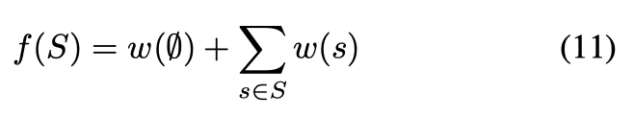
Modularity
Theorem 2 (Modularity). A set function f : 2 ^{V} → R is modular if and only if for any subset S ⊆ V it can be expressed as
for some weight function w : V → R.

Slide 21

Maximization of monotone increasing submodular functions
Maximization of monotone increasing submodular functions is NP-hard, but the so-called greedy heuristic can be used to obtain a solution that is provably close to the optimal solution.
The greedy algorithm for (6) starts with an empty set, S 0 ← ∅ , computes the gain ∆( a | S_{i} ) = f(S_{i} ∪ { a } ) − f(S_{i}) for all elements a ∈ V \ S_{i} and adds the element with the highest gain:
The algorithm terminates after k iterations.

Slide 22
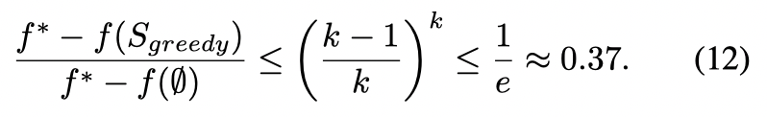
Maximization of monotone increasing submodular functions
Theorem 3. Let f ∗ be the optimal value of the set function optimization problem (6), and let f(S_{greedy}) be the value associated with the subset S greedy obtained from applying the greedy algorithm on (6). If f is submodular and monotone increasing, then
This is the best any polynomial time algorithm can achieve, assuming P = NP. Note that this is a worst-case bound; the greedy algorithm often performs much better than the bound in practice.

Slide 23

Trace of the Gramian
Solve the Lyapunov equation
Theorem 4. The set function mapping subsets S ⊆ V to a linear function of the associated controllability Gramian, f(S) = tr(CW_{S} C^{T} ) for any weighting matrix C ∈ R ^{p×n} , is modular.
Proof: …
Theorem 4 shows that each possible actuator placement gives an independent contribution to the trace of the controllability Gramian.
One needs only to compute the metric individually for each possible actuator placement, sort the results, and choose the best k.

Slide 24

Trace of the inverse Gramian
We assume in this subsection that for any S ⊆ V the associated Gramian W_{S} is invertible. This is the case, for example, if the network already has a set of actuators that provide controllability and we would like to add additional actuators to improve controllability.
Theorem 5. Let V = { b ₁ , ..., b _{M} } be a set of possible input matrix columns and W _{S} the controllability Gramian associated with S ⊆ V . The set function f : 2 ^{V} → R deﬁned as
is submodular and monotone increasing.
Proof:…
It means that adding an actuator to the system cannot decrease its controllability.

Slide 25

Log determinant of the Gramian
We now consider the log determinant of the controllability Gramian. We assume again that for any S ⊆ V the associated Gramian is invertible. We have the following result.
Theorem 6. Let V = { b ₁ , ..., b _{M} } be a set of possible input matrix columns and W _{S} the controllability Gramian associated with S ⊆ V . The set function f : 2 ^{V} → R, deﬁned as
is submodular and monotone increasing.
Proof: …

Slide 26
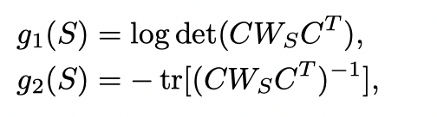
Log determinant of the Gramian
Corollary 1. The related set function g : 2 ^{V} → R deﬁned by g(S) =n log √ det W _{S} is submodular and monotone increasing.
Corollary 2. Let V = { b ₁ , ..., b _{M} } be a set of possible input matrix columns and W S the controllability Gramian associated with S ⊆ V . The set functions g 1 , g 2 : 2 ^{V} → R deﬁned as
where C ∈ R ^{p×n} with p ≤ n and rank(C) = p, are submodular and monotone increasing.
Proof: …

Slide 27

Rank of the Gramian
One way to handle cases where the controllability Gramian is not invertible is to consider its rank. The following result shows that this is also a submodular set function.
Theorem 7. Let V = { b ₁ , ..., b _{M} } be a set of possible input matrix columns and W _{S} the controllability Gramian associated with S ⊆ V . The set function f : 2 ^{V} → R, deﬁned as
is submodular and monotone increasing.
Another way to handle uncontrollable systems is to work with related continuous metrics deﬁned for uncontrollable systems, such as the trace of the pseudoinverse tr(W _{S}^{T})

Slide 28
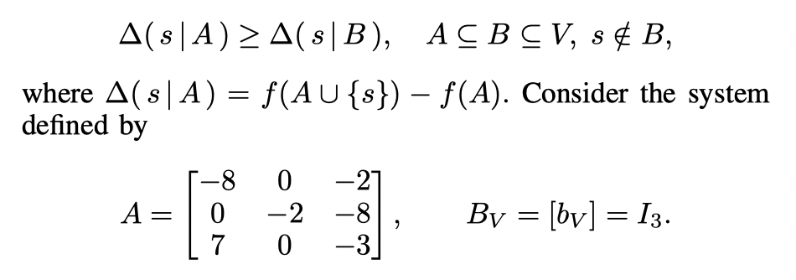
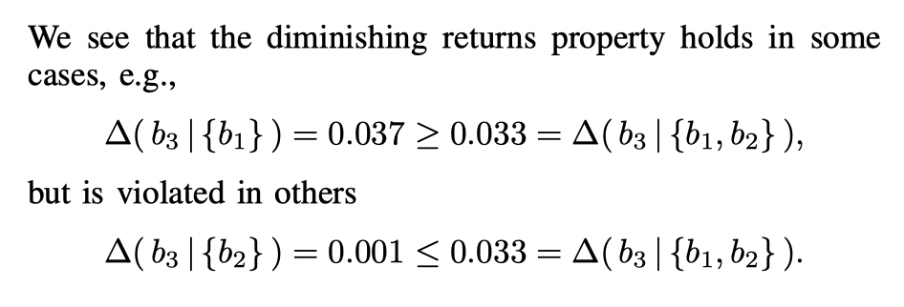
Smallest eigenvalue of the Gramian
We show an example where this function violates the diminishing gains property (7) of a set function f(S):

Slide 29
Dynamic network centrality measures
Network centrality measures are real-valued functions that assign a relative “importance” to each node within a graph.
In the context of complex dynamical networks, the controllability metrics described above can be used to deﬁne a control energy-based centrality measures, describing the importance of a node in terms of its ability to move the system around the state space with a low-energy time-varying control input.

Slide 30
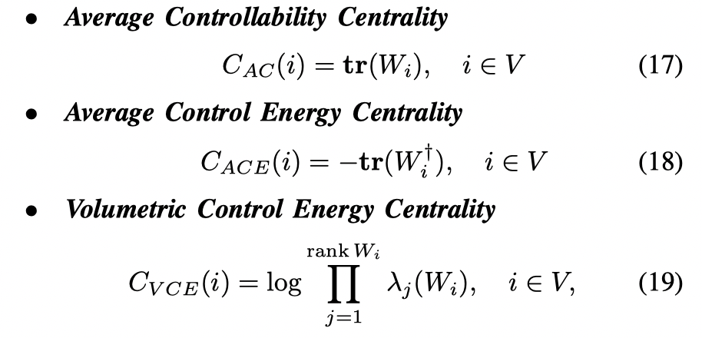
Dynamic network centrality measures
Deﬁnition 4 (Control Energy Centralities). Given a complex network with n nodes and an associated stable linear dynamics matrix A ∈ R ^{n×n} , we deﬁne the following Control Energy Centrality measures for each node I
where W _{i} is the inﬁnite-horizon controllability Gramian that satisﬁes AW _{i} + W _{i} A ^{T} + e _{i} e _{i} ^{T} = 0.
Notes:
These measures provide more relevant quantities of centrality than purely graph based measures in the context of dynamical systems and control, and can give quite a different view of what nodes are important.

Slide 31
Computational scaling for large networks
Computational techniques that can be used to scale the greedy algorithm described previously to large structured networks：
Low Rank Solutions: Exploit sparsity and compute low rank solutions to Lyapunov equations using specialized algorithms (e.g., Cholesky factor-alternating direction implicit algorithm).
Parallel Computation: Pre-compute Gramians for each actuator in parallel; Solve Lyapunov equations in parallel and sum results for overall solution.
Efficient Marginal Gains: Compute marginal gains in parallel using low rank update formulae (e.g., Sherman-Morrison formula, matrix determinant lemma).
Accelerated Greedy Algorithm: Use Minoux's accelerated greedy algorithm to reduce computation of marginal gains, leveraging submodularity for significant speedups.

Slide 32
04
Numerical examples

Slide 33
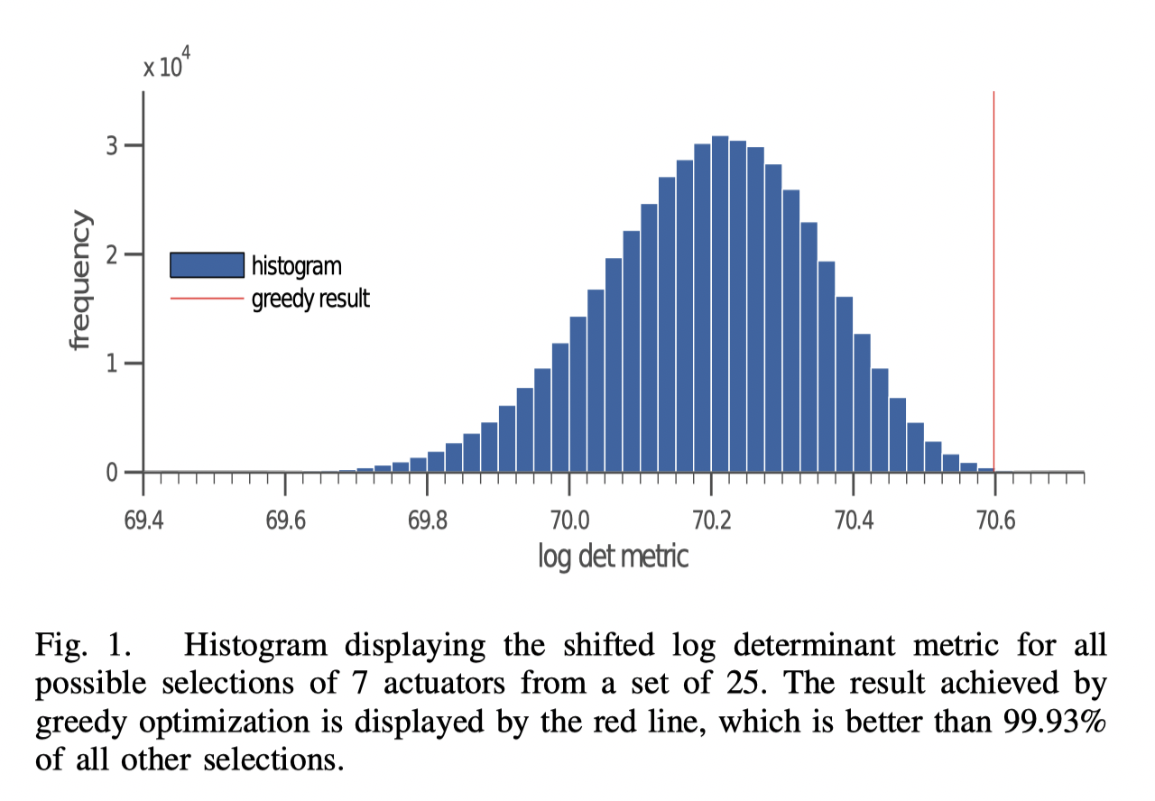
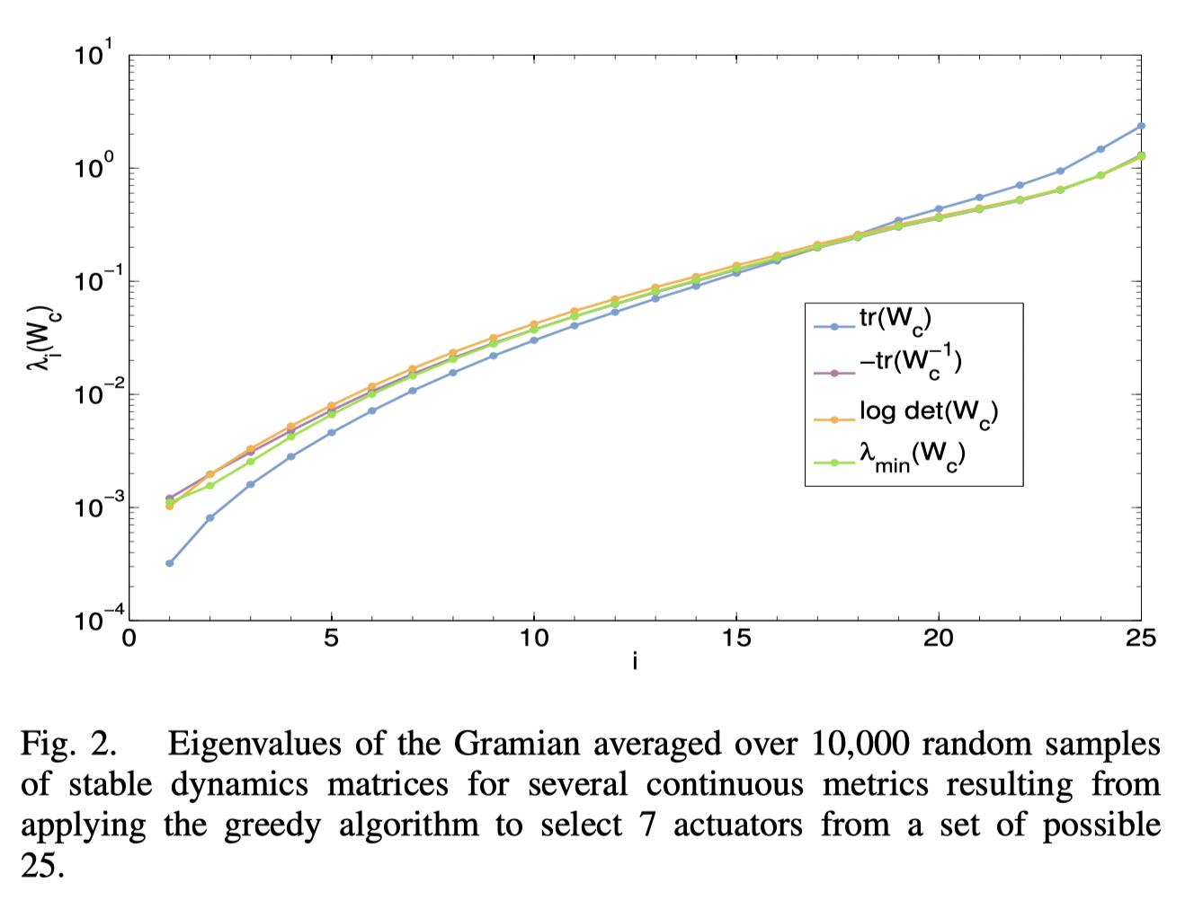
Greedy performance on random systems
We use Matlab’s rss routine to generate a stable dynamics matrix with random stable eigenvalues. We use V = { e ₁ , ..., e _{n} } , where e _{i} is the ith unit vector in R ^{n} , i.e., we assume one can choose states in which a control input can be injected.

Slide 34
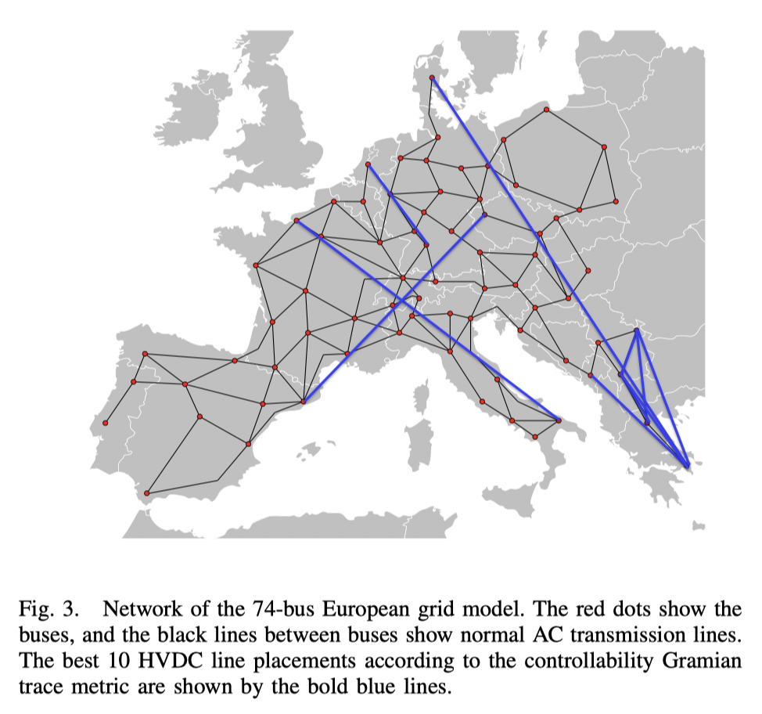
Power electronic actuator placement in the European power grid
The 10 best placement out of 2701 possible locations of power electronic devices, such as HVDC links, in a simplified model of the European power grid with 74 buses, each connected to a generator and a load, to improve transient stability by modulating power injections. (5.6x10^27)

Slide 35
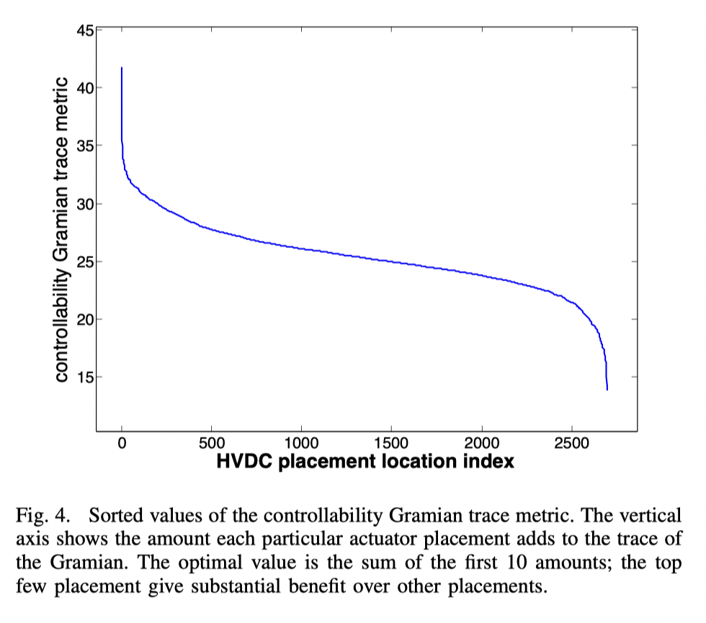
Power electronic actuator placement in the European power grid

Slide 36
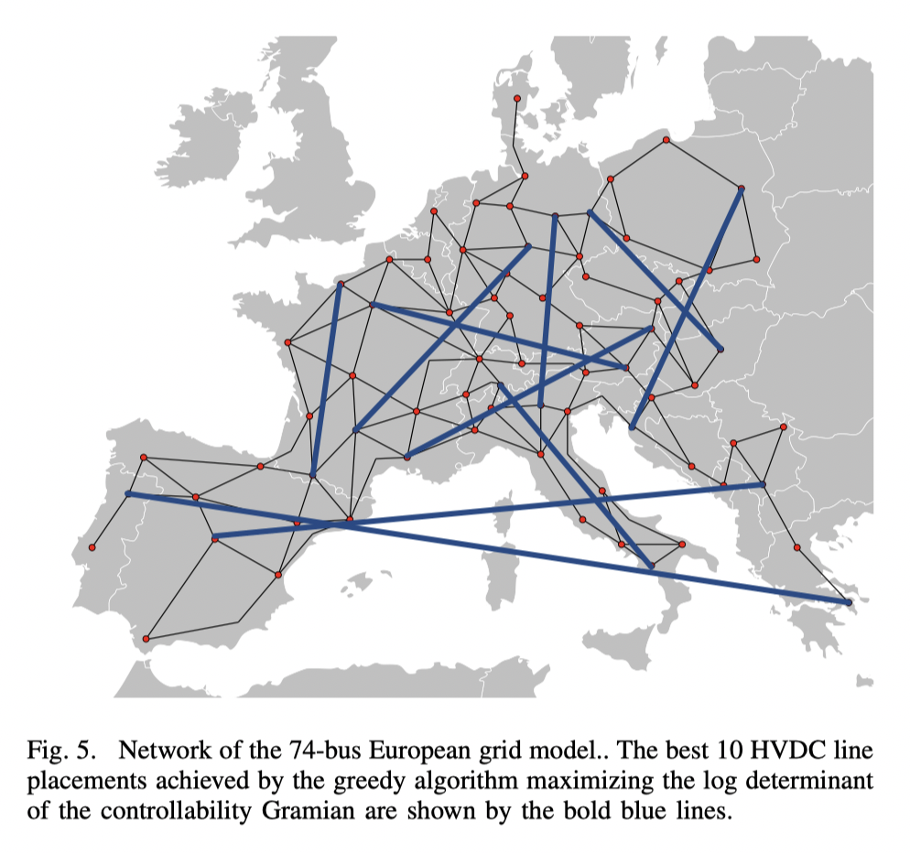
Power electronic actuator placement in the European power grid
Compared to the trace metric, we see that the lines are in general longer, connecting buses that are further apart, and more evenly distributed in the network, and no node is part of more than one HVDC line.

Slide 37
05
Conclusions and outlook

Slide 38
Conclusion and outlook
Optimal actuator placement problems in complex dynamical networks are in general difﬁcult combinatorial optimization problems; however, we have shown that an important class of metrics related to the controllability Gramians yield modular and submodular set functions.
By duality, all of the results hold for corresponding sensor placement.
Several dynamic Control Energy Centrality measures were put forward.
The results were illustrated via placement of power electronic actuators in a model of the European power grid.
Some open problems…

Slide 39
Thanks!
Do you have any questions?

